Slide 1


Amazon Sales Analysis
This comprehensive analysis examines key performance indicators from Amazon's sales data, providing valuable insights to drive strategic decision-making operations.
By Neha Mondal

Slide 2
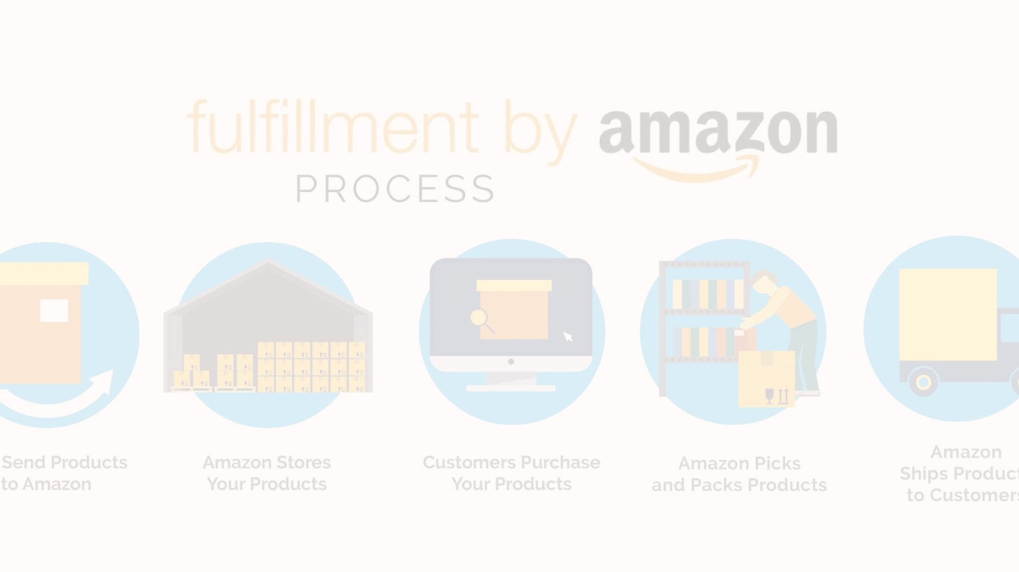
The Data-set
Comprehensive Scope
Granular Details
Timely Data
Regional data
The dataset is frequently updated, ensuring the analysis reflects the most current sales performance and market dynamics.
This data set has information on what regions and countries the orders were taken, which provides us knowledge about Amazon outreach globally.
The dataset covers a wide range of Amazon product categories, providing a holistic view of the company's diverse sales activities.
The data includes granular information on individual product sales, allowing for in-depth analysis and identification of trends.

Slide 3

Key Performance Indicators
Revenue
Profit Margin
No. of product sold
Total sales revenue generated by Amazon, providing a high-level view of overall business performance.
The ratio of net profit to total revenue, indicating the company's financial efficiency and profitability.
Tracking product sales provides valuable insights into demand, trends, and informs decisions on inventory, pricing, and marketing.

Slide 4
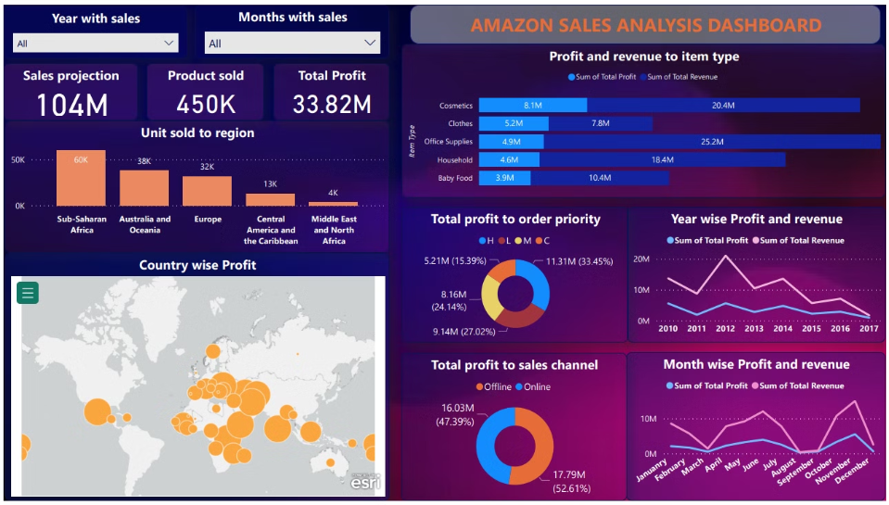

Amazon sales Power BI Dashboard

Slide 5

Analyzing the Data
Sub-Saharan Africa has most the no. of Unit sold
Revenue generated maximum for Office Supplies and minimum for Cloths sectors
Middle East & Africa has least no. of Unit sold
Cosmetics sector gave us most profit where as baby food sector gave us least profit
The difference between revenue generated and profit is large for both Office Supplies and household items
Ordering online is preferred sightly more than the ordering offline.
The few countries with the most profits: Iran, Mexico, Azerbaijan, Turkmenistan, Djibouti, Romania, etc.
Few countries with least profits: Russia, UK, Portugal, The Gambia, Albania.
we see a seasonal increase in profits in May-July and October-December.

Slide 6
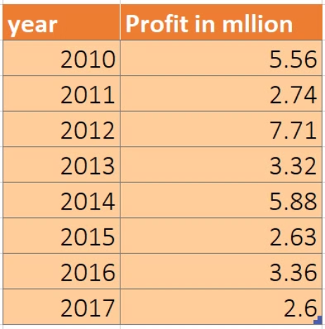
Comparing yearly profit
we had maximum profit in 2012 and minimum in 2017. we also observe a decrease in total profit in recent years.

Slide 7

Recommendations
Enhance Customer Experience
Optimize Operational Efficiency
Prioritize initiatives that improve customer satisfaction, such as faster delivery, easier returns, and personalized recommendations.
Invest in technology and process improvements to streamline logistics, reduce costs, and improve overall operational efficiency.
Diversify Revenue Streams
Explore new product categories and business lines to reduce reliance on a single revenue source and drive long-term growth.

Slide 8




Conclusion
Actionable Insights
The analysis provides a comprehensive understanding of Amazon's sales performance, enabling data-driven decision-making to drive business success.
Continuous Improvement
Ongoing monitoring and analysis of the data will be crucial to adapt to changing market conditions and capitalize on emerging opportunities.
Strategic Alignment
The findings from this analysis should be closely integrated with Amazon's overall business strategy to ensure alignment and maximize impact.

